Slide 1
Light Detection with Ultra-High Dynamic Range
Group 35
DoHyun Kim, Leran Firer, and Eric Kleinberg
Client: Prof. Jon Silva

Slide 2
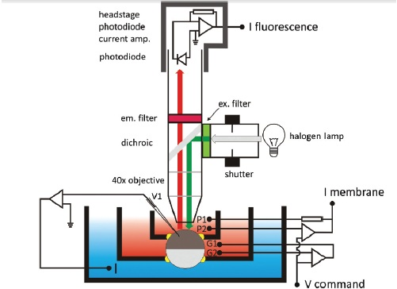
Project Review - Client Request
Dr. Silva’s studies conformational and functional change of protein/protein channels by using a fluorescence microscopy.
Notes:
Explain/review the fluorescence microscopy again.
1. Components – light input, cell submerged into patch clamp, light through cell and lens collected in PIN diode as the number of photons. PIN diode excited and elicit current. By frequency analysis of the current, models of protein kinase can be established.

Slide 3
Project Review - Client Request
Background Signal ≈ nA
Signal of interest ≈ pA → SNR is approximately 0.1% → Client requested to build a system with a higher SNR by reducing noise
Reducing Noise
By matching Lens and PIN diode
By lowering temperature of the system
By Input constraint and Filtering system of External circuit

Slide 4
Project Review: specific design requirements
System | Requirements
Electrical System | PIN Diode Responsivity at 600nm light beam Low Noise Wide Operational Temperature range Minimized Active Area Bandpass Filter of 5 kHz to 10 kHz Amplifier with a gain of 100 or larger Attach the system next to the SM1 adaptor
Cooling System | Peltier or other cooling method to cool PIN diode to optimal temperature (typically around -20 degrees Celsius). Cooling system must fit client’s Sm1 Adaptor.
Light Focusing System | Achromatic doublet lens Known diameter = 25mm Minimized focal length Focus to diffraction limited spot Minimize optical aberrations
Cost | 1000$
Notes:
Explain the noise source and what can we do… copy the specific design requiremets once the paper is done.

Slide 5
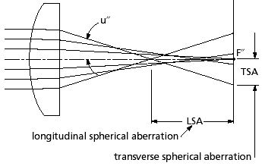
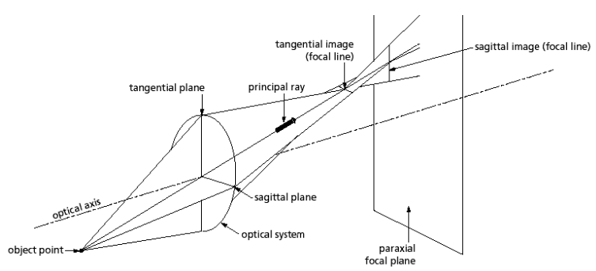
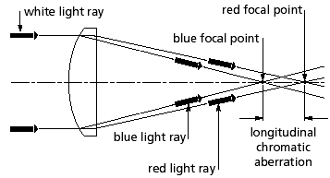
Design: Light Focusing System
Why?
Real Lens have aberrations
Spherical Aberration
Chromatic Aberration
Real Lens have astigmatism
Coma, Geometric Distortion, and Field curvature
Spherical Aberration
Chromatic Aberration
Astigmatism

Slide 6
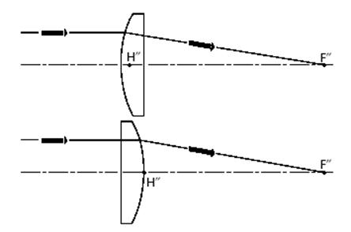
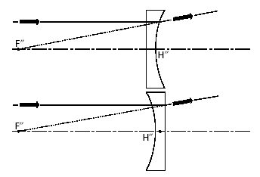
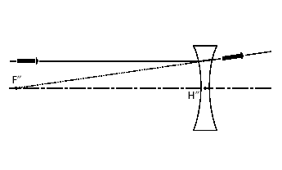
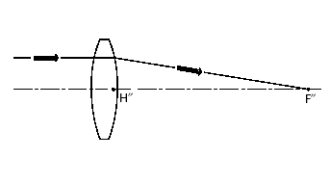
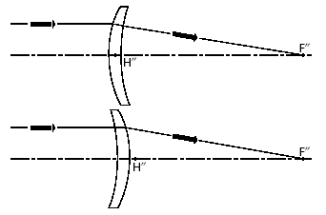
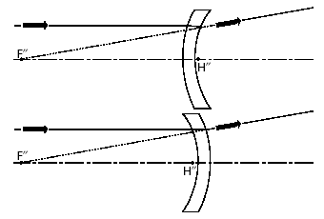
Light Focusing System cont’d
Possible Solutions: Singlet element lenses
Plano-convex plano-concave bi-concave
Bi-convex positive mensiscus negative meniscus

Slide 7
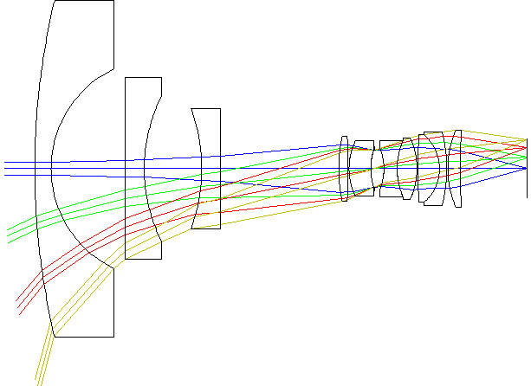
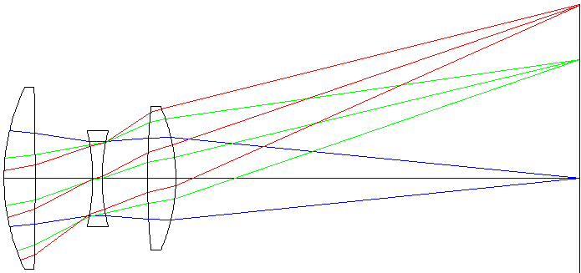
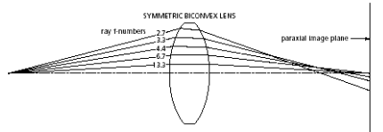
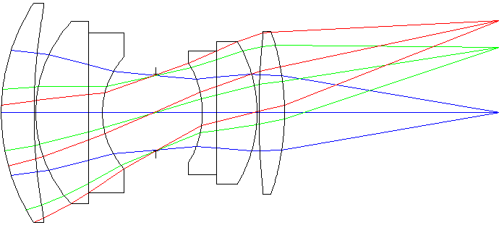
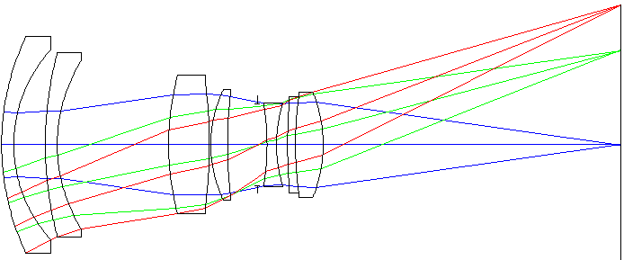
Light Focusing System cont’d
Possible Solutions: Multi-element lenses
Cooke triplet lenses Wide-angle lens
symmetric lens pairs
Double Gaussian lens Reverse telephoto lens

Slide 8
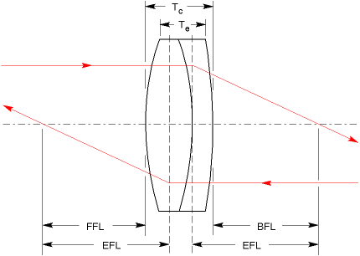
Light Focusing System cont’d
Chosen solution: Achromatic Doublet Lens
Notes:
completely eliminate the spherical and longitudinal aberration when focusing light to a diffraction limit.

Slide 9
Lens Specifications
AC254-030-A Achromatic Doublet Lens
Back Focal Length REF (mm) | 22.2
Centration (arcmin) | <3
Clear Aperture (% of diameter) | >90
Design Diameter (mm) | 25.4
Design Wavelength (nm) | 486.1 | 587.6 | 656.3
Diameter Tolerance (mm) | +0.0/-0.1
Focal Length (mm) | 30
Surface Quality | 40-20 Scratch-Dig
Thickness Tolerance (mm) | ±0.15
Weight (kg) | 0.04
$$r=\frac{2}{π}λ\frac{f}{D} →→ r=\frac{2∗C}{π}λ\frac{f}{D}$$
$$r=\frac{2∗C}{π}λ\frac{f}{D}=\frac{2∗2}{π}(0.6µm)(\frac{30mm}{25mm})$$
$$r=0.916 µm$$
A=πr²=2.64 µm²

Slide 10
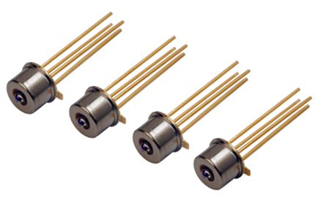
Design: Electrical System _ PIN Diode Selection
Responsivity at 600 nm wavelength
Low Noise: Thermal Noise + Dark Current Noise
Low Capacitance
Operating Temperature
Size of active area
Notes:
Explain the Reasoning.

Slide 11
Design: Electrical System _ PIN Diode Selection
 | Weight | PIN_10AP | PIN_10DP(I)/SB | PIN_APD032 | PIN_FD07 | PIN_FD15 | PIN_HR(s)008(L) | PIN-RD100(A)
Ultra Low Noise | 10 | 10 | 10 | 10 | 10 | 10 | 10 | 10
Low Capacitance | 8 | 0 | 0 | 10 | 10 | 10 | 10 | 10
Temperature Range | 5 | 6 | 6 | 10 | 9 | 9 | 9 | 7
Responsivity at 600nm | 9 | 7 | 8 | 6 | 6 | 6 | 7 | 9
Diode Activation Area | 8 | 9 | 9 | 5 | 6 | 5 | 9 | 3
High Speed Circuit | 4 | 0 | 0 | 2 | 2 | 2 | 2 | 2
 | Total | 265 | 272 | 322 | 335 | 327 | 368 | 320

Slide 12
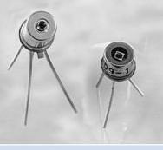
Design: Electrical System _ PIN Diode Selection
PIN-HR(S)008(L) Specification
Product Used in Design | PIN-HR(S)008(L)
Manufacturer | UDT Sensor. Inc Phone: 310) 978-0516 http://www.udt.com
Price | $22.00 to $246.00** (Price varies by the additional options)
Size | Diameter = 0.018 ± 0.002” Height = 0.0625” (Body + Wire) = 0.0125” (Body)
Quantity Required | 1
Operational Temperature Range(ºC) | -40 ~ 100
Responsitivity at 600nm (A/W) | 0.32
Activation Area (mm²) | 0.04

Slide 13
Design: Electrical System _ Input Constraint
Why?
In Real OP Amps, small current (μA ~ pA) flows inside of OP Amps, generating Voltage error.
Possible Solutions
Input Biasing
Current to Voltage Converter
Notes:
Nah~~ phew pA error, who care? -> We do care

Slide 14
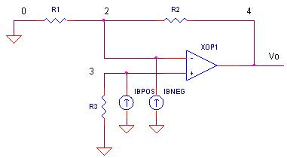
Input Biasing
Ib = Input Biasing Current (μA to pA)
Advantage: Can cancel the Voltage error.
Disadvantage:
Require Client changing variable resistance for his experiments.
Output of the system is Current.

Slide 15
AC Current to Voltage Converter
Advantage:
Electrical system input becomes Voltage source.
Minimized Current Induced in following OP Amps.
Disadvantage:
Commercial Products can only convert the current of μA to mA
Literature Search: A low-noise and wide-band ac boosting current-to-voltage ampliﬁer for scanning tunneling microscopy
Tunneling Microscopy
Specialized current to voltage converter for pA to nA Current.
Unity Gain at 5 kHz to 10 kHz

Slide 16
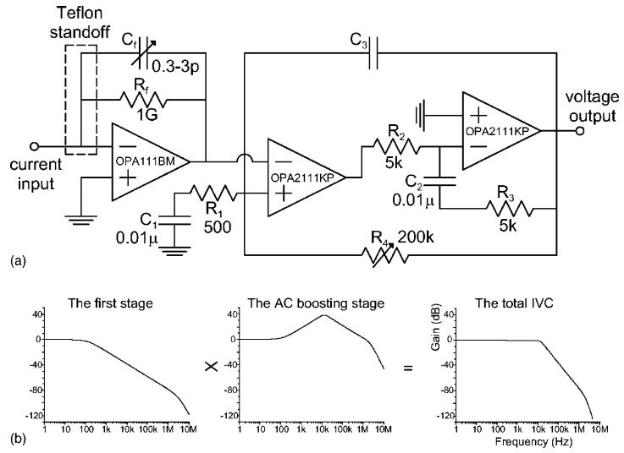
AC Current to Voltage Converter
Design Adopted from the literature

Slide 17
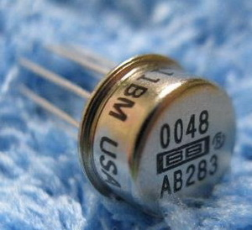
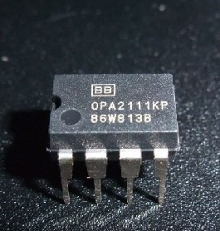
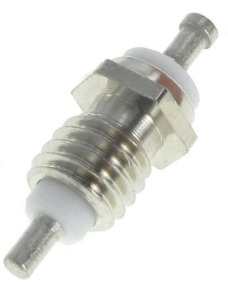
AC Current to Voltage Converter
Product Used in Design | OPA111BM | OPA2111KP | Tefalon Standoff – PTFE Insulated Terminal Pins
Manufacturer | Burr Brown Corp. Phone: 520) 746-1111 http://www.burr-brown.com | Burr Brown Corp. Phone: 520) 746-1111 http://www.burr-brown.com | Keystone Electronics. Corp http://www.keyeleco.com
Price | $53.35 | $15.23 | $1.00 ~ $4.00
Size | 9.08 x 9.08 x 4.4 mm³ | 9.3 x 6.5 x 6.6 mm³ | Not determined yet
Quantity | 1 | 1 | 1
Picture of the Product

Slide 18
Design: Electrical System _ Filter
Why?
The frequency information of current generated can be decoded for the protein conformation change.
Domain of Frequency of interest: 5 kHz to 10 kHz
Preserve the shape of the original signal!
Possible Solutions
Analog Filter
Passive Bandpass Filter
Active Bandpass Filter
Bessel Filter
Butterworth Filter
Chebyshev Filter
Digital Filter

Slide 19
Analog Filter: Passive vs. Active
Passive Filter
Advantage: Easy and Cheap to build
Disadvantage:
Use of Inductors
The characteristics of filter affected by following circuit.
Active Filter
Advantage:
No Inductors
Feedback system improving the performance and predictability
Disadvantages:
External power supply is Required
Rather expensive compared to Passive Filter
→ Use Active Filter

Slide 20
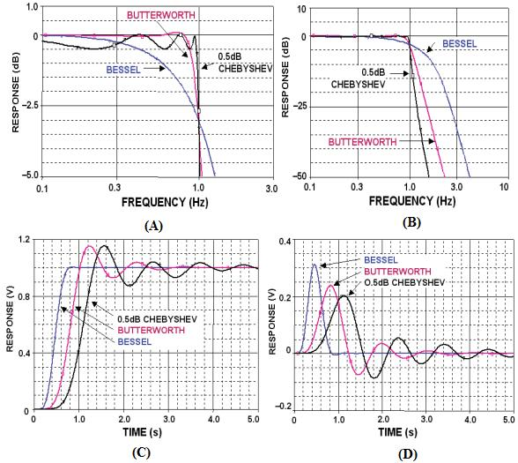
Active Filter
Bessel Filter // Butterworth Filter // Chebyshev Filter
Use Bessel Filter.

Slide 21
4th order Bessel Bandpass Filter Design
Center Frequency FM= 7.5KHz
Bandwidth B= 5kHz
Q= FM/B = 1.5
Center Gain Km = 1 (absolute value); it’s is an unity gain filter
From the Coefficient of the 4th order Filter Table a1 = 1.3617 b1 = 0.6180 α = 1.2711 (at Q = 1.5)
Fm1 = FM/ α = 5900.4 Fm2 = FM* α = 9533.3
C = 10 nF

Slide 22
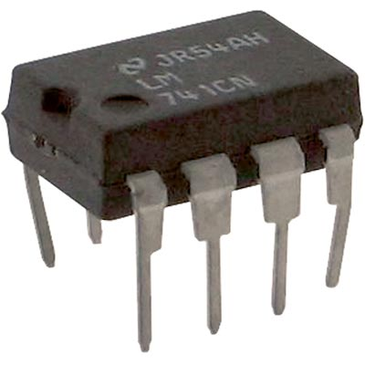
4th order Bessel Bandpass Filter Design
Product Used in Design | OP Amp 741
Manufacturer | Texas Instruments .Inc Phone: (512) 434-1560 http://www.ti.com/
Price | $0.10 ~ $ 0.15
Size | 7.112 x 10.15 x 6.857 mm³³
Quantity | 2
Picture of the Product

Slide 23
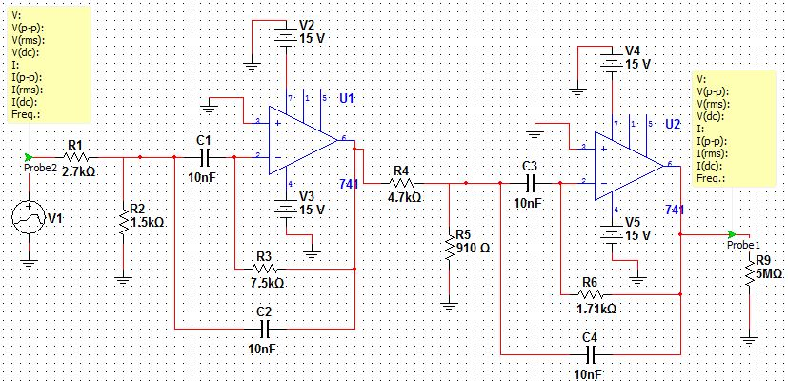
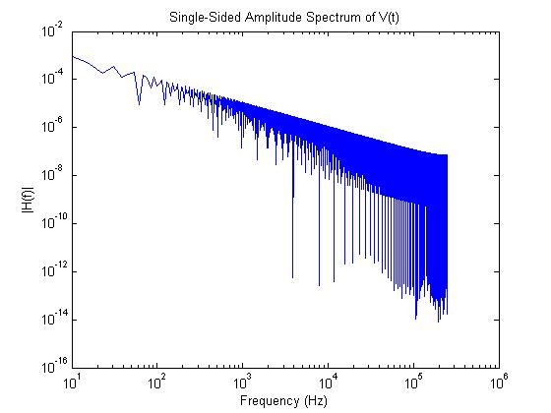
4th order Bessel Bandpass Filter Simulation
In Troubleshooting Phase

Slide 24
Design: Electrical System _ Amplifier
Why?
Small Signal - approximately ~ 0.1 % of background signal
Possible Solutions
OP Amps
Easy to build.
Various Configurations – Differential, Instrument, and etc.
Diode Amplifier
Diode connected to OP Amps to control the current flow.
Transistor Amplifier
DC Biasing
Use Transistor Amplifier.

Slide 25
Transistor Amplifier Design
From Sdera/Smith, MicroElectronic Circuits, 6Ed, Oxford University Press, 2011. Ch.5, P.432- P.450, the common source MOSFET transistor amplifier with a single power supply implemented design was adopted.
The MOSFET transistor
kp = 2.0e-5
dimensions of 100μm x 100 μm (Length x Width).
Used DC analysis and AC analysis

Slide 26
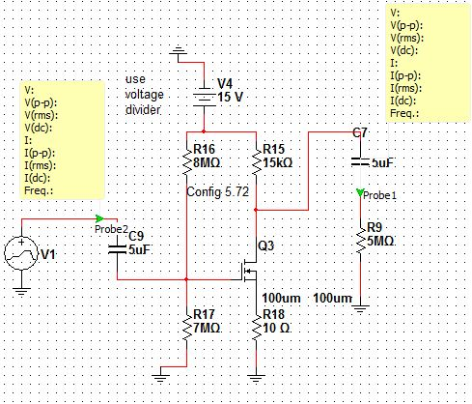
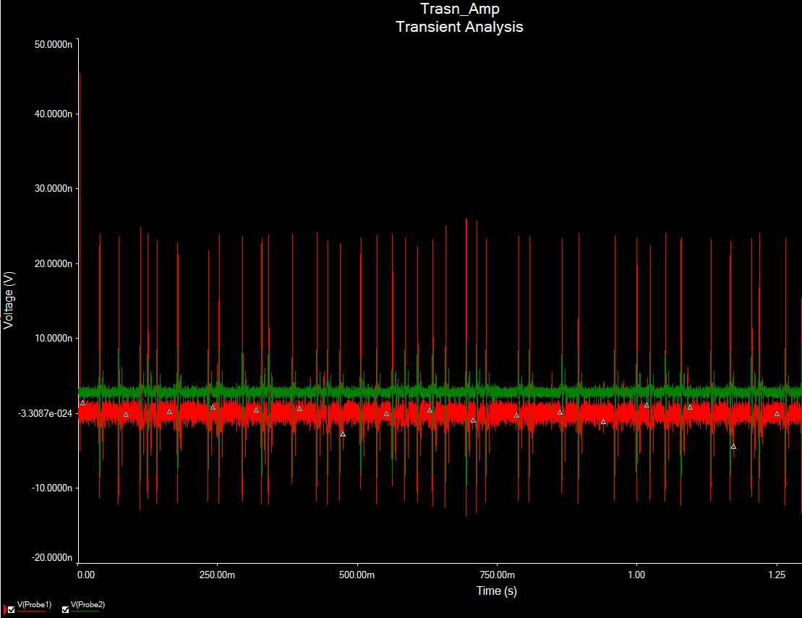
Transistor Amplifier Design and Simultion
Gain of the design = 2.991
Phase shift = 180º
Can be increase the Gain by cascading series of amplifier or adding an OP Amp

Slide 27
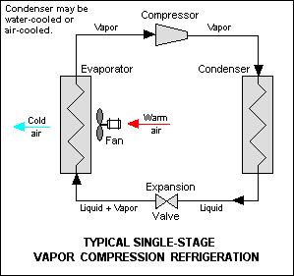
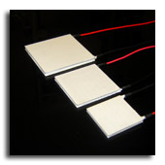
Design: Cooling System.
Why?
Minimize Thermal Noise
Cooling Methods:
Open Air Cooling.
Liquid Nitrogen Cooling.
Refrigeration
Peltier Cooler
Notes:
Open air cooling does not work because the temperature we want to reach is too low, and because there is not enough space for the necessary fan.
Liquid Nitrogen does not work because the temperature produced by liquid nitrogen is too cold for the photodiode/electronics, and because it would cause water damage to the circuitry due to condensation.
Refrigeration does not work because of the size limitation of the SM1 adaptor and because of the expense in designing a custom refrigeration unit.
Peltier works because it can be applied at small length scales, and is localized cooling, meaning it does not cool the surroundings (minimal if any condensation effects/circuitry damage).

Slide 28
Peltier Cooler Analysis
Normally calculation is performed based on an expected thermal load in Watts.
In our case, there is no load. The PIN diode must be cooled relative to ambient temperature.
Team discussed this with an engineer at Tellurex, a Peltier Cooler Company.
His advice was to pick a Peltier that fit our size constraints, and to then adjust the cooling amount by increasing or decreasing the DC current applied to the cooler.

Slide 29
Design: Peltier Cooler Selection
 | Weight | C2-04-0101 | C2-06-0902R | 00801-9X30-10RU3 | C2-06-0402R | C2-04-0102 | 00301-9X30-10RU2
Qmax | 7 | 5 | 10 | 4 | 8 | 5.5 | 3
dTmax | 6 | 8 | 8 | 8.5 | 8 | 8 | 8.5
A | 10 | 7 | 6.5 | 9 | 7 | 8.5 | 10
B | 10 | 7 | 3 | 9 | 7 | 8.5 | 10
H | 10 | 7 | 7 | 9 | 7 | 8.5 | 10
 | Total | 230 | 283 | 349 | 314 | 341.5 | 372
Notes:
Most important was dimensions. Qmax and dTmax are parameters of the cooler, on how much it can maximally cool.
A,B, and H are the dimensions, and are most important given our size constraint.

Slide 30
Design: Specific Peltier Cooler
Product Used in Design | 00301-9X30-10RU2 Single Stage Mini Peltier Cooler
Manufacturer | Custom Thermoelectric, Inc. Phone: (443)-926-9135 http://www.customthermoelectric.com/index.htm
Price | $25.50
Quantity | 1
Picture of the Product

Slide 31
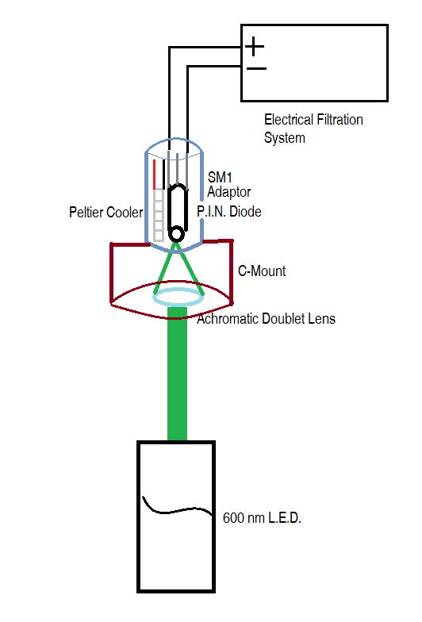
Integrated System Schemetics

Slide 32
Design Schedule

Slide 33
Team Responsibilities
Team Member | Specific Role
Eric Kleinberg | Research and Design of Peltier (TEC) Cooling System Website Development Schematic Development
Leran Firer | Research and Design of Optical Focusing System Lens Selection Designsafe Analysis
Dohyun Kim | Research and Design of Electrical Circuitry PIN Diode Selection Filter Simulation.

Slide 34
Questions?

